Slide 1
Schools Cloud Transformation Programme
Stuart Wakefield
Chief Information Officer
Ministry of Education

Slide 2
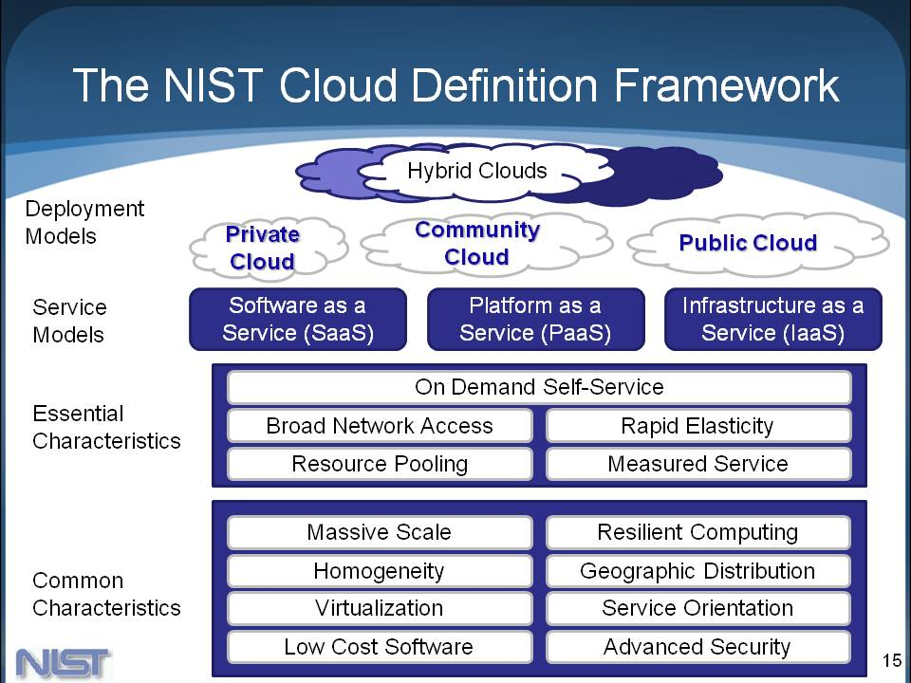
Defining Cloud

Slide 3

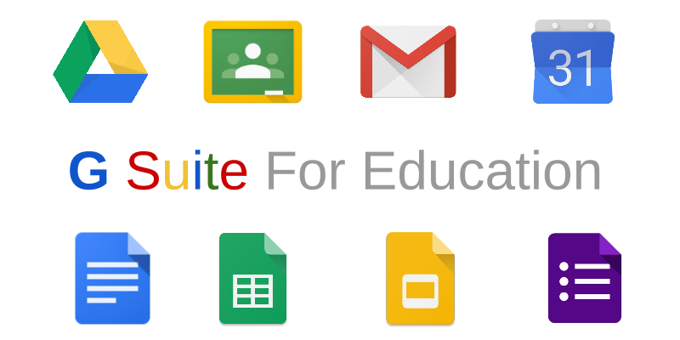




Common Cloud Examples
IaaS/PaaS SaaS

Slide 4
Schools Cloud Programme ”Moving spend out of the server room and into the classroom”
A standardised but not centralised approach
Initial focus on Microsoft & Google office productivity & commonly used software (eg SMS, LMS, Library)
Commercial outcome – “Software as a Service” (SaaS)
Enable schools to exit ALL on-premise server infrastructure
Enable greater levels of inter-operability
Time Frame
2016 Proof of Concept
2017 Pilot Programme
2018 Full rollout

Slide 5
Schools Cloud End State
At the school
In the Cloud
Office 365 Suite
Email
Storage
Office productivity
PC’s, Laptops, Tablets, Smartphones etc
Collaboration
Communication
Website
Google Apps for Education
Email
Storage
Office productivity
Projectors,
Smartboards
Collaboration
Communication
Website
SMS
Cloud Infrastructure Services
Printers
Identity Mgt
LMS / ePortfolio
Sensors
Device Mgt
Library Mgt
Vendor Managed
Compute
Storage
Finance Mgt
Backup

Slide 6

2016 Proof of Concept
Seven (7) schools were part of the Proof of Concept
Six (6) were fully migrated from on-site servers to public cloud services
The seventh school migrated their on-site hosted SMS to Azure IaaS
Migrated applications and resources from on site servers to a mix of Office 365, G Suite for Education and the N4L router

Slide 7

Proof of Concept - Objective
Prove the feasibility of delivering;
School software and infrastructure via a cloud service
Integration software to support Communities of Learning
A standard approach to system integrators assessing, moving and supporting a school’s transition to the cloud
The scope of the PoC included four key objectives
Remove dependency on servers
Standardise Identity
Increase Collaboration
Administration Efficiency
Notes:
Notes under the scope of the PoC section are as follows:
Under Shifting schools to the cloud:
The Ministry vision of what cloud services may look like with today’s capabilities including Software as a Service (SaaS) and Infrastructure as a Service (IaaS) is known by schools.
Under Identity
Schools are able to manage their own accounts in their own tenancy in the cloud, a school can have a hybrid identity and access management solution.
Under Collaboration
The new tools that support collaboration in a digital environment for a school and across a Community of Learning
Under Administration Efficiency
School administration efficiencies can be made by using a single tool to aggregate data between schools (for CoLs) and between the Ministry and the School.

Slide 8
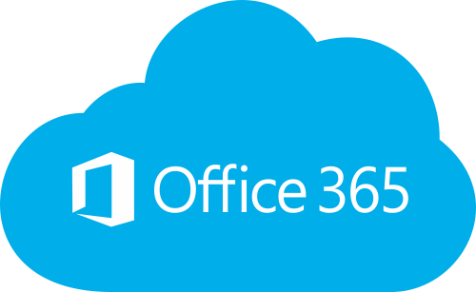
Proof of Concept - Approach
Upgraded all devices to the latest OS (Win 10, El Capitan)
Set up both Office 365 and G Suite for Education
All individual files to One Drive, Shared files to SharePoint
On premise library systems moved to SaaS versions
Training of all staff on the new technologies

Slide 9
Key Learnings - Technical
A school’s network must be fit for purpose before the school migrates to the cloud
Be prepared (time & cost) for remedial work before a migration
Some older systems do not run efficiently on Cloud (IaaS)
Existing printers may not support cloud print
Large file transfers may be slower
Backup/Recovery plans may need to change

Slide 10
Key Learnings - Support
Staff need training before, and support during and after the migration
Post migration support is key to helping staff navigate their way around the new environment and to explore and exploit new features
Changes are likely to existing technical support arrangements with the new environment (working this out with your IT provider is a key step on the migration plan)
Changing technology does not simply lead to a change in behaviour. It needs leadership, support, professional development and change management

Slide 11
Key Learnings - Benefits
Anywhere, anytime access for both staff and students
Cost savings by moving to the cloud instead of replacing on-site servers, and lower support costs
Better security and privacy
Better identity and access management
Security maintained by hosting provider
Disaster recovery / data loss prevention improved

Slide 12
Key questions to ask
Service Levels
Availability, performance
Data
who owns the data, where is it hosted
Contract
minimum contract term, rights on termination
Billing arrangements & price certainty
Security & Risk
what is provided & how is it assured
Migration Assistance

Slide 13
Additional Resources
For IT providers:
Playbook
“START” tool
http://services.education.govt.nz/cloud/resources/
For Schools:
Contact your existing IT provider or inhouse team
Cloud Programme (pilot group)
Connected Learning Advisory service
Local Ministry team

Slide 14
Student Info Sharing (SISI)

Slide 15
SISI - Interoperability

Slide 16
Identity & Access Management
Establish an individuals identity reliably at point of first contact
eg: at time of enrolment or employment
Match to government’s authoritative identity records & maintain this linkage to survive underlying changes in identity
eg: registers held by DIA
Enable all users to only need a single logon credential in order to access systems and services they require
ie: use your primary logon to access everything
Leverage existing IAM systems to the maximum extent possible
eg: Google, Microsoft, RealMe , Tahi
Take an active risk management approach
eg: introduction of biometrics when needed

Slide 17












IAM Approach
Logon Credentials
Parents & whānau
Roles & Relationships
Learners
Identity Data
Education workforce
shared platform with DIA

