Slide 1


Move your school to the cloud with

Slide 2
Schools Cloud Programme ”Moving spend out of the server room and into the classroom”
A standardised but not centralised approach
Initial focus on Microsoft & Google office productivity & commonly used software (eg SMS, LMS, Library)
Commercial outcome – “Software as a Service” (SaaS)
Enable schools to exit ALL on-premise server infrastructure
Enable greater levels of inter-operability
Time Frame
2016 Proof of Concept
2017 Pilot Programme
2018 Full rollout

Slide 3
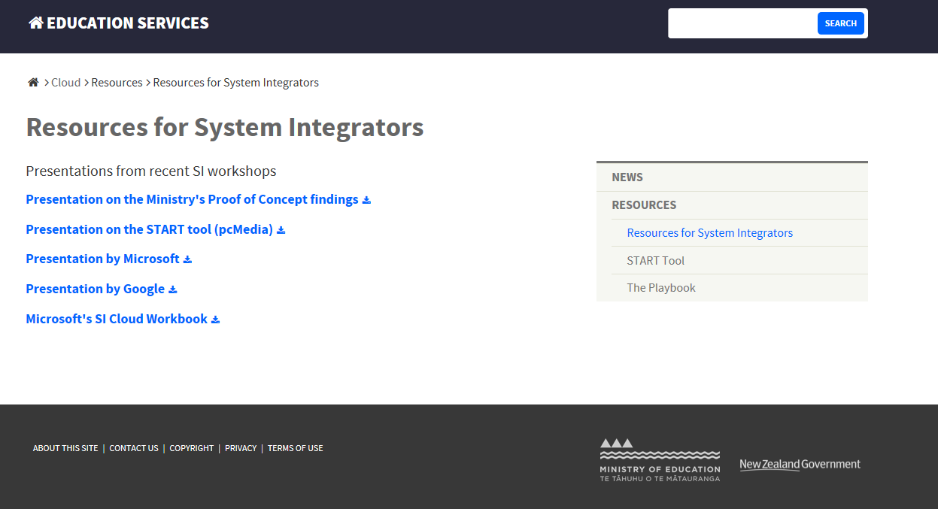
Find out more from MoE
http://services.education.govt.nz/cloud/

Slide 4
Pointers to a successful Migration
Understanding the needs of the school
Administration Systems
Communication / Collaboration
Classroom digital plan
Tailored Professional Development
Technical Product Knowledge
Create a whole of school solution
Notes:
Tailoring the solution to not just fit their administration system but to fit their teaching and learning.
What the background is , what the aspirations are, cost structures are.
Not just providing support for the transition process, but following up with on-going PLD to completement skills development and improve classroom outcomes.
Understanding collaboration structure. Syndicates, leadership team etc.
Make the IT support the school

Slide 5
Technical Details
Is the network fit for purpose?
Working through the schools devices
Identifying applications
Which of these are not cloud ready?
Explore server use
Provide a school specific Cloud Solution

Slide 6
Platform Integration
Combine all your Cloud applications into one Single Sign-on
Automation of the Provision Cloud Services
Make the cloud storage easy to use and familiar.
Made easy with School Data Sync

Slide 7

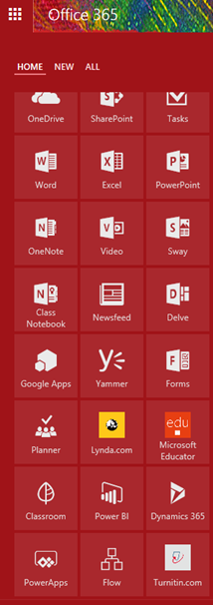
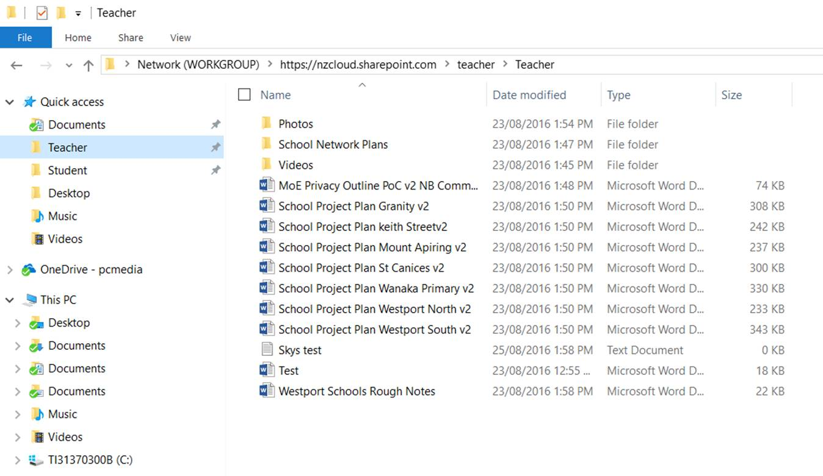
Make it easy

Slide 8
Cost Savings
Examples:
250 child primary, quoted $28,000 server replacement with a life of 3 years plus $15,000 p.a support contract.
Compared to a typical cloud migration of $6000 - 8000 one off cost and on-going support drops by 50%.
In the last 12 months we have saved schools over $1m.

Slide 9
Nayland College
MoE Cloud Pilot Secondary School
Migration completed over 12 months by pcMedia. All services now Cloud based with the exception of KAMAR.
“We have been able to save $150,000 that has been reinvested into classroom tools and resources,” Daniel Wilson, Principle, Nayland College

Slide 10
The learners are the winners
IT expenditure being transferred to the classroom.
New classroom devices
Better collaboration (remove hurdles of having data on a server)
Contributing to better learning outcomes.

Slide 11
Expertise and Proven Record
Delivered MoE Cloud Proof of Concept.
Delivering majority of Pilot Schools.
Winner Microsoft Education Partner Awards 2016 and 2017
Education Qualified staff
Link between technical expertise and educational experience.

Slide 12

“You quickly built positive working relationships with staff and never made the various IT capabilities of staff feel judged….. You developed your structure around the needs and wants of the staff, rather than the IT technician, putting our needs first and this was greatly appreciated…. So a very big thank you” Linda Ireton, Keith Street School
“over the course of the past six months [pcMedia] have worked professionally alongside our staff to enact our shared vision of a future-proofed network that provides greater functionality, less network down-time, …. and file access anywhere, anytime”. Daniel Wilson, Nayland College
“I have to say they have been amazing from start to finish - they did a full review of our IT systems and provided us with lots of information before they started work….. Not only did they move us to the cloud but they also fixed our internet issues” Wendy Bamford, Wanaka Primary

Slide 13
Free Site Visits
Visit to discuss MoE Cloud Pilot
ICT audit of your school
Visit to discuss centrally funded PLD on Digital Fluency and assistance with applications
Visit from a Microsoft Teacher Ambassador

Slide 14

Fill in your details to win a Robot

Slide 15

Questions?

